Slide 1
Survival Analysis – Part 1
Nina Gunnes
January 21, 2021

Slide 2
Survival time
Time from a starting point until an event of interest occurs
Time from birth to death
Duration of marriage
Time from treatment to relapse of a specific disease
Starting point sometimes harder to define than endpoint
When is the actual onset of a disease? Using time of diagnosis instead?
Endpoint not necessarily something negative, such as illness or death
Can be, e.g., recovery from a disease or spontaneous vaginal delivery

Slide 3
Survival time, cont.
Not always referring to survival in a traditional sense
Also known as time-to-event data
Rarely useful to calculate mean survival time
Requires that endpoint actually occurs and is observed for all subjects
Survival data rarely normally distributed
Survival data analyzed by using special methods

Slide 4
Censoring
Exact time of endpoint not known
Event of interest not observed for all subjects at end of study
Survival time only partly known (e.g., “at least as large as”)
Often due to data collected during a limited period of time
Three main types
Right-censoring
Left-censoring
Interval-censoring

Slide 5
Censoring, cont.
Right-censoring due to study termination or loss to follow-up
Several possible reasons for being lost to follow-up
Not responding to questionnaires or attending scheduled hospital visits
Study withdrawal
Moving or emigration
Death (by a cause other than that being studied)
A common phenomenon
Routinely handled in survival analysis

Slide 6
Censoring, cont.
Study participant 1
Event of interest
Study participant 2
Right-censoring
Study participant 3
Study participant 4
Study participant 5
Study participant 6
0 years
2 years
4 years
6 years
8 years
Start of study
End of study
Observation time

Slide 7
Survival curves
Survival data useful to answer important questions
Do people live longer today than 50 years ago?
Has treatment of breast cancer improved with respect to survival?
Do patients live longer after treatment with a new drug?
Results from survival studies often presented by survival curves
Displaying the proportion of subjects still “alive” after a certain time
Starting at 1 (or 100%) since all subjects are “alive” at the starting point
Declining towards 0 as more and more subjects reach the endpoint

Slide 8
Survival curves, cont.

Slide 9
Survival curves, cont.

Slide 10
Median survival time
Important statistic for survival data
Time at which at least 50% of the subjects have “died”
Can be read from the survival curve
Drawing a straight horizontal line from the 0.5 (50%) mark on the y axis
Finding the point on the x axis where the line crosses the survival curve
Inspecting the survival curves for men and women
Curve for women above curve for men
Higher median survival time for women than for men

Slide 11
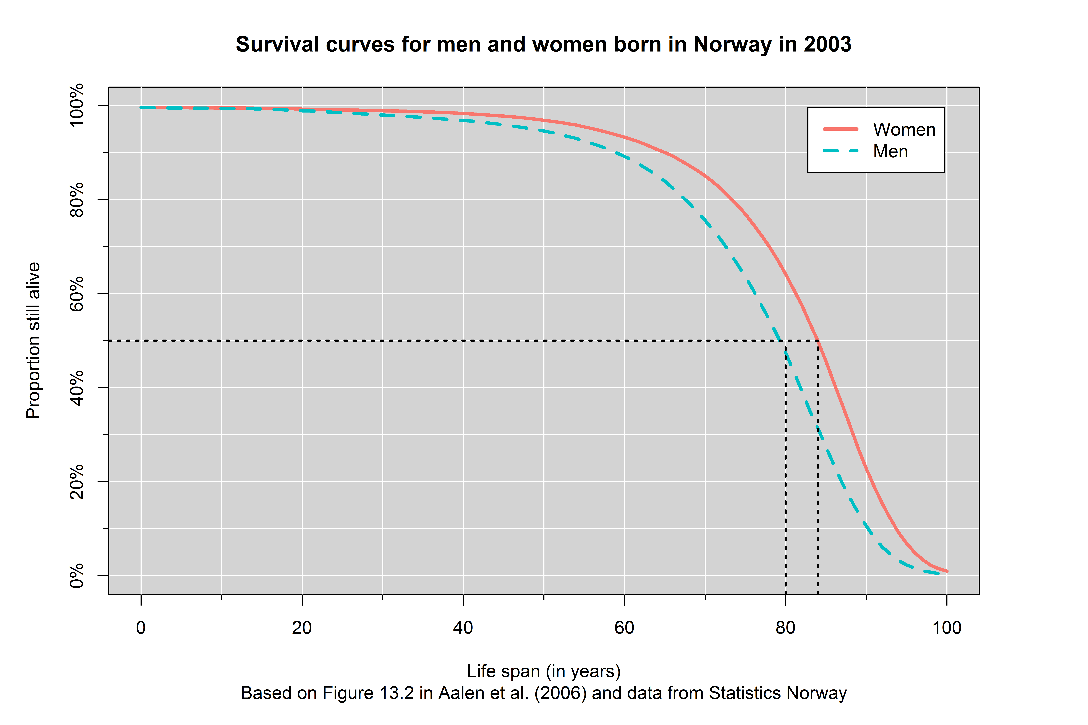
Median survival time, cont.

Slide 12
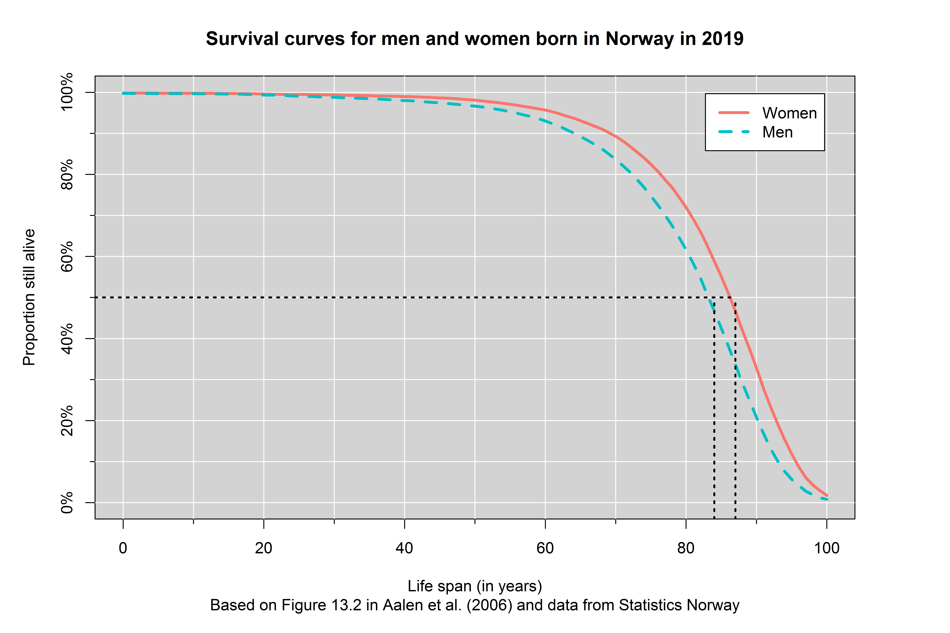
Median survival time, cont.

Slide 13
Kaplan-Meier plot
Survival curves constructed by using the Kaplan-Meier method
Calculating the survival probability at each observed endpoint
Considering an example of malignant melanoma
Survival data on 16 patients who have undergone surgery
Observation time (i.e., time from surgery to death or censoring)
Status at the end of observation time: 1 – dead, 0 – alive (censored)
Number of patients alive and under observation right before observation time
Survival probability

Slide 14
Kaplan-Meier plot, cont.
Observation time (in years) | Status | Number alive and under observation | Survival probability
0.10 | 0 | 16 | 1.0
0.64 | 1 | 15 | 0.933
0.97 | 0 | 14 | ―
1.81 | 1 | 13 | 0.862
2.35 | 1 | 12 | 0.790
2.65 | 1 | 11 | 0.718
2.69 | 1 | 10 | 0.646
3.59 | 1 | 9 | 0.574
4.44 | 1 | 8 | 0.503
4.60 | 0 | 7 | ―
4.63 | 1 | 6 | 0.419
4.90 | 0 | 5 | ―
5.32 | 0 | 4 | ―
5.76 | 0 | 3 | ―
6.18 | 1 | 2 | 0.209
6.83 | 0 | 1 | ―
Based on Table 13.1 in Aalen et al. (2006)

Slide 15
Kaplan-Meier plot, cont.
Survival curve starting at 1 at time 0
Survival curve remaining constant until first death
First death at 0.64 years
One patient censored at 0.10 years
15 patients alive and still under observation right before 0.64 years
Calculating the probability of surviving 0.64 years
$1−\frac{1}{15}=0.933$
Survival curve dropping to 0.933 and remaining constant until next death

Slide 16
Kaplan-Meier plot, cont.
Next death at 1.81 years
One patient censored at 0.97 years
13 patients alive and still under observation right before 1.81 years
Calculating the probability of surviving 1.81 years
$\left(1−\frac{1}{15}\right)×\left(1−\frac{1}{13}\right)=0.933×0.923=0.862$
Survival curve dropping to 0.862 and remaining constant until next death
Next death at 2.35 years
12 patients alive and still under observation right before 2.35 years

Slide 17
Kaplan-Meier plot, cont.
Calculating the probability of surviving 2.35 years
$\left(1−\frac{1}{15}\right)×\left(1−\frac{1}{13}\right)×\left(1−\frac{1}{12}\right)=0.933×0.923×0.917=0.790$
Survival curve dropping to 0.790 and remaining constant until next death
…
Survival curve dropping at each death
Remaining constant between two subsequent deaths
Censoring only affecting the number alive and still under observation
Eventually dropping to 0 if last observation is a death (not a censoring)

Slide 18
Kaplan-Meier plot, cont.

Slide 19
Kaplan-Meier plot, cont.

Slide 20
Kaplan-Meier plot, cont.

Slide 21
Kaplan-Meier plot, cont.
Based on some assumptions
Independent survival times
Starting point and endpoint clearly defined and not changing during the study
Life expectancy not changing too much during the study
Censoring and endpoint independent of each other
Dependent censoring if censoring depends on survival time
Illustrated by studying how long you can ride a carousel without throwing up

Slide 22
Log-rank test
Based on the Kaplan-Meier method
Used to comparing survival time in two groups
Treatment with a drug vs. placebo
Tumor thickness in two categories
Null hypothesis of no difference in survival between the groups
Counting numbers of subjects at each time of “death”
Number still “alive” and under observation right before: $n_{1}$ and $n_{2}$
Number of “deaths”: $d_{1}$ and $d_{2}$

Slide 23
Log-rank test, cont.
Calculating total numbers of subjects at each time of “death”
Total number still at risk: $n=n_{1}+n_{2}$
Total number of “deaths”: $d=d_{1}+d_{2}$
Calculating expected numbers of “deaths” at each time of “death”
Under the null hypothesis: $e_{1}=n_{1}×d/n$ and $e_{2}=n_{2}×d/n$
Finding total observed and expected number of deaths for all times
Observed number of deaths: $O_{1}=\sum{d_{1}}$ and $O_{2}=\sum{d_{2}}$
Expected number of deaths: $E_{1}=\sum{e_{1}}$ and $E_{2}=\sum{e_{2}}$

Slide 24
Log-rank test, cont.
Calculating test statistic: $\frac{{\left(O_{1}−E_{1}\right)}^{2}}{E_{1}}+\frac{{\left(O_{2}−E_{2}\right)}^{2}}{E_{2}}$
Approximately chi-square distributed with 1 degree of freedom

Slide 25
Example: Primary biliary cirrhosis
Considering data from a study on primary biliary cirrhosis
312 patients diagnosed with cirrhosis
Referral to Mayo Clinic between January 1974 and May 1984
Patients randomized to one of two groups
DPCA (D-penicillamine)
Placebo
Patients followed until death or censoring
End of follow-up in July 1986

Slide 26
Example: Primary biliary cirrhosis, cont.
125 patients dead by the end of follow-up
65 patients in the DPCA group
60 patients in the placebo group
Study described in Chapter 3 of the book by Laake et al. (2007)
Data available at https://www.med.uio.no/imb/personer/vit/veierod/boker/epidemiologiske-og-kliniske-forskningsmetoder/datafiler/

Slide 27
Example: Primary biliary cirrhosis, cont.

Slide 28
Example: Primary biliary cirrhosis, cont.

Slide 29
Example: Primary biliary cirrhosis, cont.

Slide 30
References
Aalen OO, Frigessi A, Moger TA, Scheel I, Skovlund E, Veierød MB. Statistiske metoder i medisin og helsefag. Oslo: Gyldendal akademisk; 2006.
Laake P, Hjartåker A, Thelle DS, Veierød MB. Epidemiologiske og kliniske forskningsmetoder. Oslo: Gyldendal akademisk; 2007. https://www.med.uio.no/imb/forskning/publikasjoner/boker/2007/epidemiolgiske-kliniske-forskningsmetoder.html.

